Slide 1
Health Journey

Slide 2
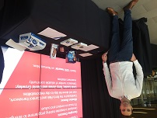
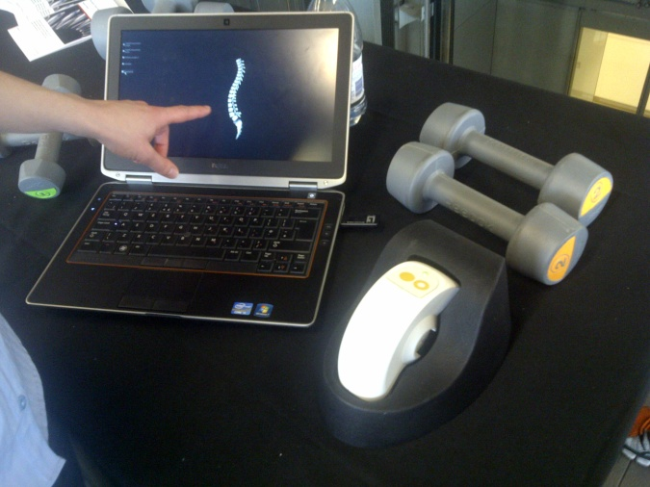
Our Health Journey
Measuring Health Risk
76%
Feel Fatigued
at least once a week
% Healthy | 2014 | 2015 | 2016 | 2017 | 2018
Smoking | 75% | 68% | 72% | 94% | 95% not smoking
Nutrition | 58% | 56% | 47% | 48% | 41% Eating Healthy
Alcohol | 82% | 81% | 70% | 71% | 69% drinking sensibly
Mental Wellbeing | 99% | 98% | 98% | 97% | 98% no signs of depression
Physical Activity | 84% | 86% | 85% | 86% | 90% have sufficient activity
15%
Smoking
Data from UK Gov 2017
19%
Obese
Body mass adjusted for waist circumference
20%
Health Checks
have measured there blood pressure cholesterol and glucose in the past year
Top 3 Risk Factors
2014 | 2015 | 2016 | 2017 | 2018
Nutrition | Musculoskeletal | Nutrition | Nutrition | Nutrition
Smoking | Nutrition | Alcohol | Alcohol | Alcohol
Alcohol | Alcohol | Smoking | Physical Activity | Physical Activity
30%
Alcohol
Exceeding recommended units

Slide 3
Innovation
We established the top Health Risks to the business
We grade it on Proactive and Reactive spend from 6 different reports delivered by external experts
We then tailored our health and wellbeing service lines to our top 10 health risks
Creating 55 health events in 2018, measured and with purpose
Offering our staff over 18 health pathways with 100 health interventions.
Musculoskeletal
Musculoskeletal - Aim Movement
DSE team from health experts
Electronic assessments with exercises
Back school and Clinical Pilates
Sit - stand desk education to move
Free health memberships
Health Assessment Back Care Module
Nutrition - Aim Education
Onsite nutritionist with one voice
Food subsidies
Healthy food counter with food markings
Healthy weight programme
Encourage grow your own
Cooking work shops
Healthy food vending
Monthly nutritional events
2018 new caterer
Cancers Aim Lifestyle Changes
More capture opportunities
Education with health assessment modules
Free services on site (Dental HVP)
Cancer talks
Encourage lifestyle changes
Support network – return to work
Substance Abuse - Aim Support
Smoking cessation Nurse and work shops
Hypnosis
Alcohol work shops
Non alcoholic drink choices
Prescription drug seminar
Family networks
Physical Activity - Aim Motivation
Award winning facility onsite
Education events about heart health
Cycle facilities and active travel to work
Running and walking programmes
Encourage business leads
Sports and social networks
Table tennis in the office
Mental Health - Aim Resilience
Free relaxation classes weekly
Workshops including family
Online resilience training tools for all
Health assessment module
Seminars & knowledge of EAP
Accessible alternative therapy
Medical triage service
OH training for managers
New intranet page with linked support
Nutrition
Physical Activity
Mental Health
Cancers
Substance Abuse
Notes:
Cancers Aim Lifestyle Changes
More capture opportunities
Education with health assessment Modules
free services on site (Dental HVP)
Cancer Talks
Encourage lifestyle changes
Support network – return to work
Physical Activity - Aim Motivation
Award winning facility onsite
Education events about heart health
Cycle facilities and Active travel to work
Running and Walking programmes
Encourage business leads
Sports and social networks
Table Tennis in the office
Substance Abuse- Aim Support
Smoking cessation Nurse and work shops
Hypnosis
Alcohol work shops
Non alcoholic drink choices
Prescription drug seminar
Family networks
Mental Health - Aim Resilience
Free relaxation classes weekly
Workshops including family
Online resilience training tool for all
Health assessment module
Seminars
Knowledge of EAP
Accessible alternative therapy
Medical Triage Service
OH training for Managers
New Intranet Page with linked support
Musculoskeletal - aim Movement
DSE team from health experts
Electronic assessments with exercises
Back school and Clinical Pilates
Sit - stand desk education to move
Free health memberships
Health Assessment Back Care Module
Nutrition - Aim Education
Employed a nutritionist
One nutritional voice and message
Food subsidies
Healthy Food Counter
Health food markers
Healthy weight programme
Encourage grow your own
Cooking work shops
Module in our Health Assessments
Healthy Food Vending
Monthly Nutritional Events
2018 New Caterer

Slide 4
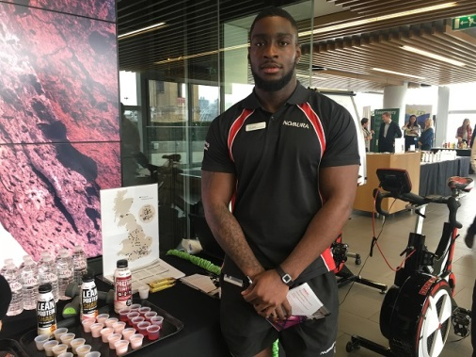
Musculoskeletal
% Of Respondents
KEY INDICATORS | Perceived Data | Clinical Data |  |  | 2018
 | BRITAIN’S HEALTHIEST COMPANY | HEALTH ASSSESSMENTS | OCCUPATIONAL HEALTH | PRIVATE MEDICAL INSURANCE AXA
Total number of users | 311 | 643 | 168 | 878 | 2000
No of Participants at risk | 205 | 430 | 34 | 428 | 1097
66% reported one or more MSK conditions compared to section benchmark of 76%
4% of OH MSK referrals have had a accident outside of work
Shoulder injuries had the most claims in PMI
Display Screen Equipment 1412 risk assessment completed

Slide 5
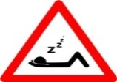
Health Risks v Reactive Spend
Main Key Areas:
Musculoskeletal
Captured1644
£ change -20%
Cardiovascular Captured 1103
£ change -3%
Nutrition
Captured 974
£ change +16%
Resilience
Captured 313
£ change +19%
Sleep
Captured 315
£ change 0 %
Other areas of concern:
Reproductive
Captured 390
£ change -49%
Skin
Captured 390
£ change - 5%
Substances
Captured 337
£ change 0%
Lungs / Airway
Captured 287
£ change -8%
Cancers
Captured 55
£ change +55%

Slide 6
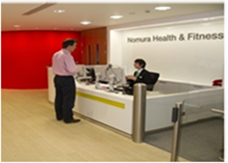
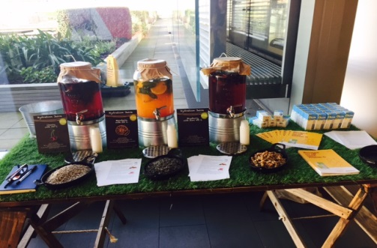
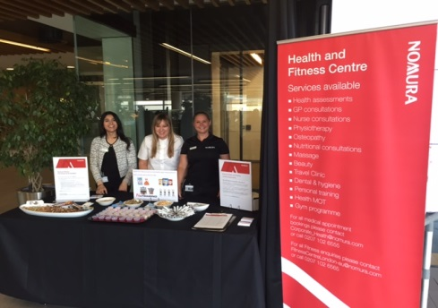
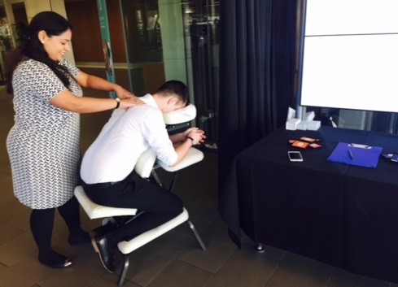
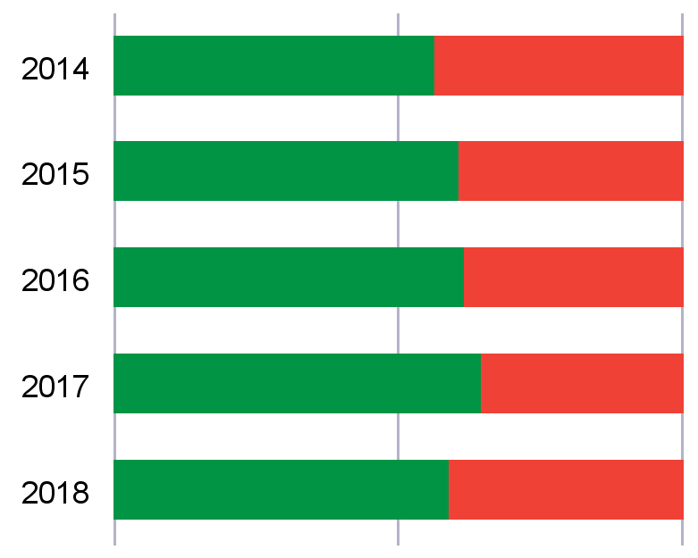
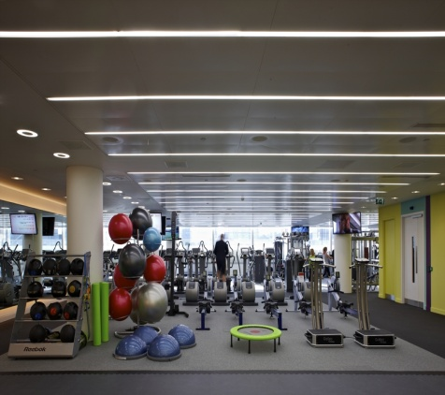
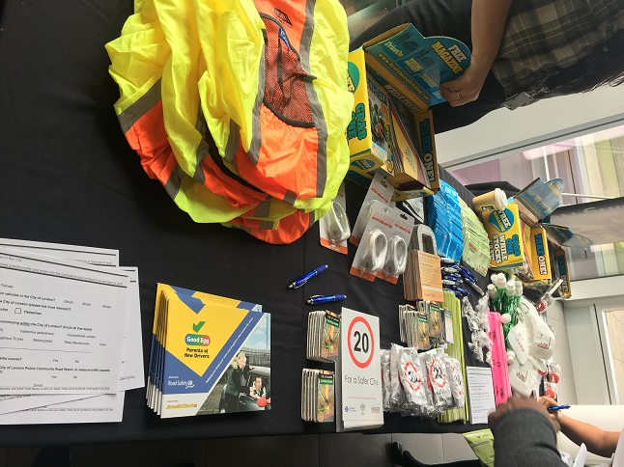
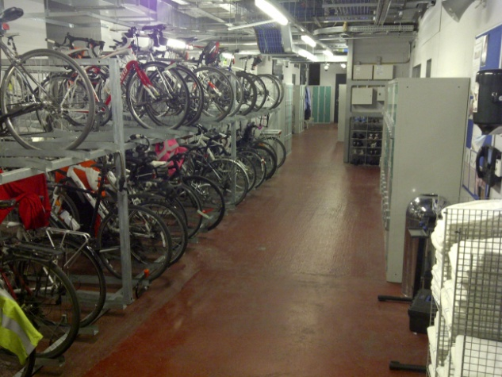
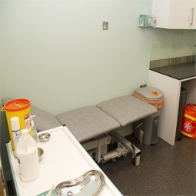
Measured Outcomes
RISK | 2018
Lost Productivity | 8.6%
Accordingly, the total percentage of working hours lost to absenteeism and
presenteeism sector average of 12.7% and Top 5 firms of 9.2%
Have Accessible and Supported Services
Know and Understand Your Health Risks
Create a Culture

