Slide 1

The current policy environment for occupational health
Nick Pahl, CEO

Slide 2
Contents
1 Current Issues
2 Recent Reports, Infographics, Reports and Policy activity
3 Green Paper on Work/ Health and Disability
4 Role of Occupational Health
5 Questions
6 Vision for the future

Slide 3
1 Current Issues

Slide 4
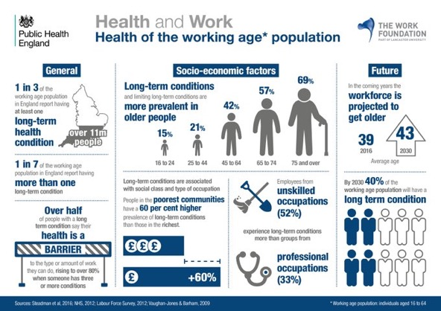

Slide 5
Ageing workforce
Increasingly complex health needs. 1 in 7 of working age (almost 5m people) in England managing multiple health conditions while seeking to maintain their working lives
Only half of those with multiple conditions are in work, compared to 66% of those with a single long-term condition. For multiple conditions included a mental health condition, the employment rate dropping to just 33%. Disabled people much less likely to be in work
Barriers to entry into work and return to work

Slide 6
Source: Annual Population Survey April 2015 - March 2016

Slide 8
Cancer
Cancer survivors are 1.4 times more likely to be unemployed than general population
65% of cancer survivors think it’s important to continue to work
Key issues – reasonable adjustments, coping at work, discrimination and unhelpful and unsympathetic employers
Materials from Macmillan available (stand 70)
Notes:
Charities include Age UK, MIND, Centre for Better Ageing, Society of Geriatrics

Slide 9
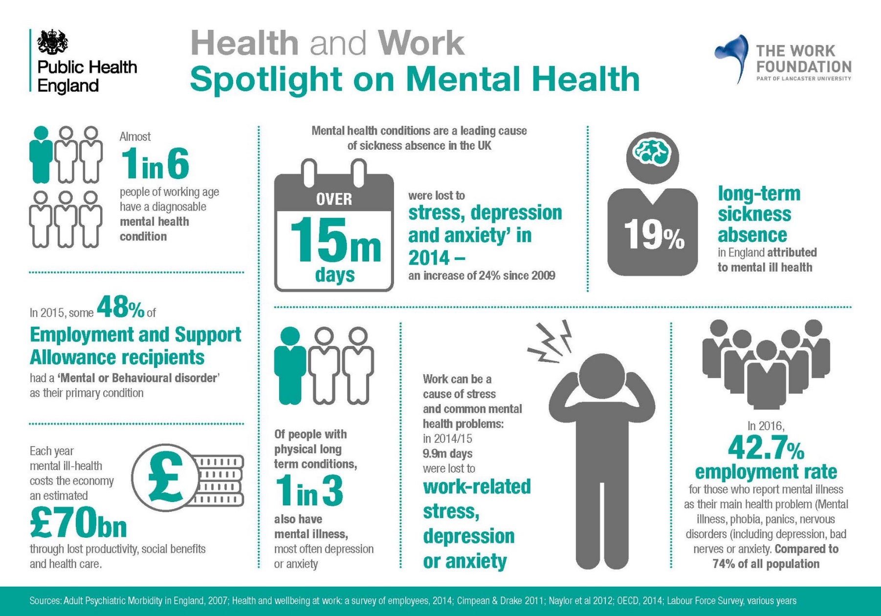

Slide 10
Occupational health and medicine
Significant gaps in provision of occupational health – particularly for small business
Training posts for specialist occupational physicians are at an all-time low, down from 216 in 2002 to just 74 in 2015.
Ageing specialty; 64% of all doctors working in occupational medicine are aged 50 or over, and half of all specialists could retire within a decade.

Slide 11
2 Recent reports/ toolkits / info graphics / guidance and Policy Activity

Slide 12
Reports / toolkits / info graphics…
MSK - Employer toolkit - BITC/ ARMA/PHE
Health and Safety Executive – new health strategy - focus on work-related stress, MSK
PHE – infographics
Ageing – infographic - Centre for Ageing

Slide 13
Reports …
Health, work and worklessness - Local Government Association
Inequality in Access to Quality Work – Carnegie Foundation
Arthritis in the workplace – Arthritis Research UK
Retention - Resolution Foundation
Disability and employment - Cardiff University
Social Prescribing/ MS/ working with multiple health conditions – Work Foundation
Reducing long term sickness absence - IPRR

Slide 14
Quality standards / advice ..
Healthy workplaces: improving employee mental and physical health and wellbeing – NICE quality standard
Advice on the menopause - FOM

Slide 15
Coming up..
Devolving spend 2017 e.g. to London
Independent Review of Employment Practices in the Modern Economy - commissioned by the PM Oct 2016. Matthew Taylor (the Chief Executive of the Royal Society of the Arts) taking forward. PM also asked CEO of MIND and Lord Stevenson to look at mental health in the workplace
NHS England publication on Hearing loss in workplace
Centre for Social Justice report – end of this month
What Works Centre for Wellbeing Strategic Council

Slide 16
3 Green Paper on Work, health and disability

Slide 17
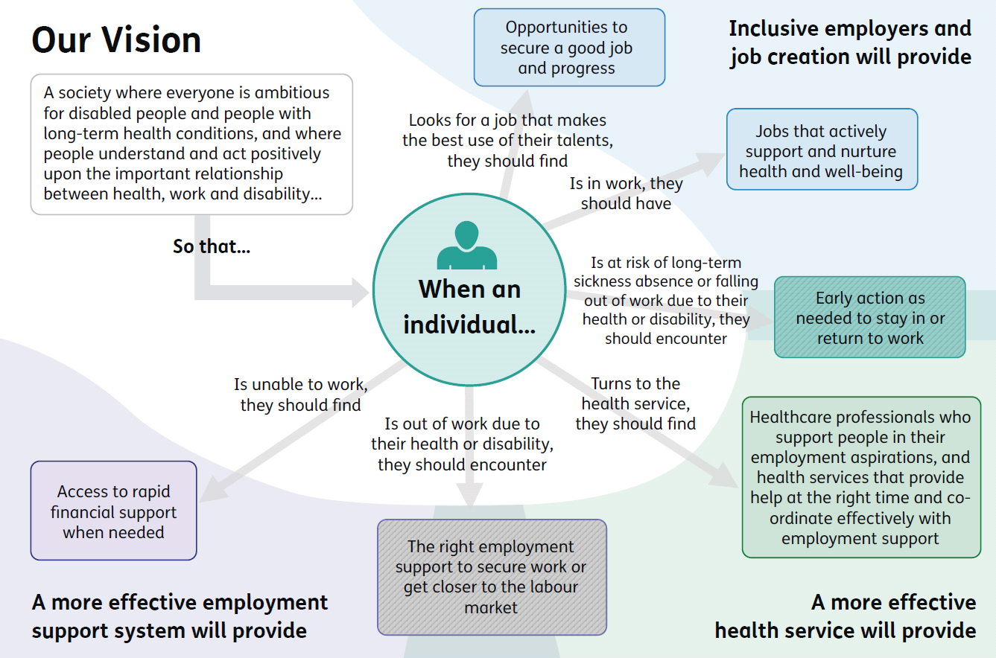
Building a shared vision

Slide 18
Action occurring already
New personal support within Jobcentre Plus
Investment in skills and capabilities for work coaches to help people with disabilities
Reform of the Work Capability Assessment, including separating decisions on financial support and employment support
Further improvements to simplify the assessment process for a small proportion of claimants with the most severe, life-long conditions

Slide 19
Questions in Green Paper
Should other health professionals be able to issue fit notes? If so, who and what qualifications / training would we expect them to undertake?
Can the fit for work service be improved – or does something very different need to replace it?
How can occupational health and medicine professionals be part of the solution?

Slide 20
Green Paper on work, health and disability – SOM involvement
Parliamentary roundtable hosted by SOM Patron, Lord Blunkett - November
SOM/FOM Consultation event for 70 health professionals in York – January
SOM/FOM Submission to DWP/DH unit - February
Campaign to increase understanding health and work: http://www.whyoccupationalhealth.co.uk/content/why-occupational-health/

Slide 21
Concerns
target is over – ambitious. On current trends it will take to 2065 to close the gap!
assumes the UK economy can deliver these jobs, and disabled people can access these jobs.
employers, particularly small employers, need to get the right support at the right time.
workforce capacity of occupational health professionals need to be expanded to deliver the new occupational health models that are required.

Slide 22
4 Occupational Health

Slide 23
Occupational health professionals
have unique training, expertise and perspective to understand the link between health and work; as well as how to help injured, ill and ageing workers remain productive and at work.
provide preventive services for the entire workforce; support services for individual employees; and competent professional support to management.
help employers to ensure a healthy workplace culture and properly organised and healthy work.

Slide 24
Role of occupational health
individuals need conversations with trusted health professionals who understand their medical needs, which may be complex, and can refer to a range of support services; medical and non-medical
employers need direct, individualised and concise advice on how to support disabled people and people with long-term health conditions in the workplace
OH professionals are ideally placed to ‘join-up’ service access and advice between individuals, their health care professionals and their employers

Slide 25
Occupational health – the evidence base
Evidence demonstrates that there is a rounded business case for investment in occupational health services
Well-integrated and supported workplace health initiatives improve employee health and productivity
Research supports the proposition that investments in occupational health add value through reduced costs associated with the prevention of ill health, improved productivity and a range of intangible benefits.
Employers state the reasons they provide occupational health service are:
Financial – to reduce costs or add value to the business
Legal – to comply with health and safety laws and regulations
Moral – it is the right/ethical/socially responsible thing to do

Slide 26
Occupational health awareness and training
Need pool of well trained and competent OH professionals e.g. in each CCG
OH needs to be added into the undergraduate curriculum for health, education and social care professionals and other specialist curriculums

Slide 27
Vision for the future

Slide 28
Work in 2030
Preventive approaches that help people stay in work and stay well
Greater flexibility in where, when and how we work
When people do develop health conditions, both employers and health professionals do much more to help them stay in touch with work, and identify the adaptations they might need to return
..not everyone will be able to stay in work – and that sometimes it will be best for them to stop. benefits system needs to support people in this situation

Slide 29

SAVE THE DATE 26TH - 28TH June 2017
Come and join us at the NEW multi-
for all Occupational Health Professionals in the fantastic location of Leeds

Slide 30
Questions?
Nick.Pahl@som.org.uk

